Slide 1
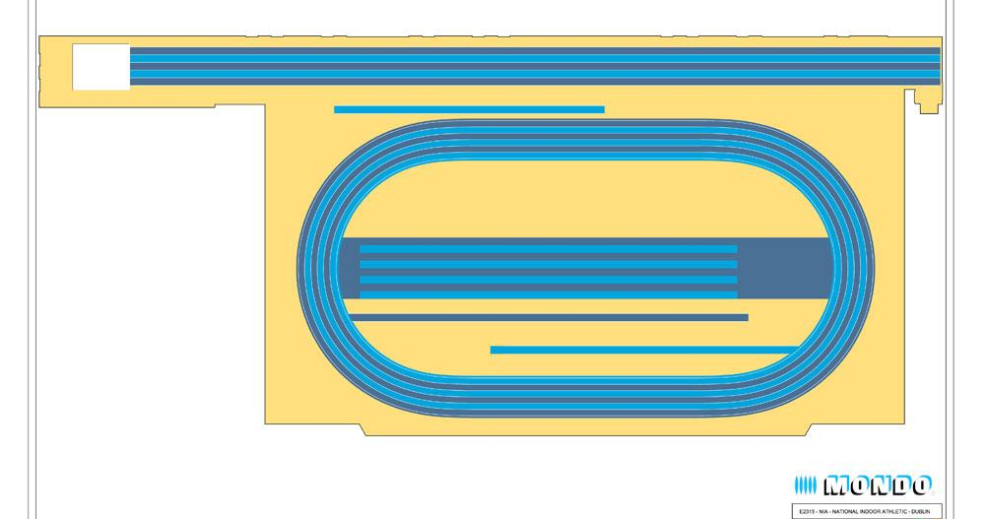
When You Arrive At The Arena
Athlete Team Zone
30 minutes before the event start bring your athletes to Athlete Team Zone.
Only Designated Coaches/Chaperones can access with the athletes. No parents.
If multiple teams, ensure athletes have their team sticker on
R= Red
B= Blue
G= Green

Slide 2
60m Athlete Flow
Athlete Team Zone
When called, bring your team to 1.Assembly Area.
Athletes will be assembled in various heats.
Officials will take athletes to 2.Race Start.
In each race, if an athlete qualifies, they will be brought to 4.Qualifiers Area by Officials.
If not, they will return to 1.Assembly area.
You will remain in 1.Assembly Area until instructed to leave with your whole team to return to the Athlete Team Zone
1
60m Heats Assembly & Cheer Area
2
60m Race Start
3
60m Race Finish
4
60m Qualifiers Assembly Area

Slide 3
Standing Long Jump Athlete Flow
1
Long Jump Assembly Area
Athlete Team Zone
When called, bring your team to 1.Assembly Area. You will know what order your team in in the rota
You will be instructed by Official to bring your team to 2.Last Call Area
Your team will wait here until the team before you in the rota complete their jumps.
When instructed, bring all your team to your jump mat at 3.Long Jump Area.
Athletes will jump one at a time & when complete return to you.
You will have your next athlete ready to jump.
When all your team complete their jumps, return to the Athlete Team Zone
2
Long Jump Last Call Area
3
Long Jump Area

Slide 4
Throws Athlete Flow
1
Throws Assembly Area
Athlete Team Zone
When called, bring your team to 1.Assembly Area. You will know what order your team in in the rota
You will be instructed by Official to bring your team to 2.Throws Area
Athletes will throw in groups of four.
You will have your next group of four athletes ready to throw.
When all your team complete their throws, return to the Athlete Team Zone
2
Throws Area

Slide 5
Relays Athlete Flow
Athlete Team Zone
When called, bring your relay team to 1.Assembly Area. Only bring the strike four members.
Other team members should return to the Athlete Team Zone and remain their with you.
Officials will bring your team to 2. Relay Last Call Area.
Athletes will race and when finished return to the Athlete Team Zone
1
Relay Assembly Area
2
Relay Last Call Area

Slide 6
Athlete Flow
1
Throws Assembly Area
1
Long Jump Assembly Area
Athlete Team Zone
2
Throws Area
1
60m Heats Assembly & Cheer Area
2
60m Race Start
3
60m Race Finish
4
60m Qualifiers Assembly Area
2
Long Jump Last Call Area
3
Long Jump Area

